Slide 1
IBM Hackathon
Creative Thinking
Analytical Thinking
Collaboration
Communication

Slide 2
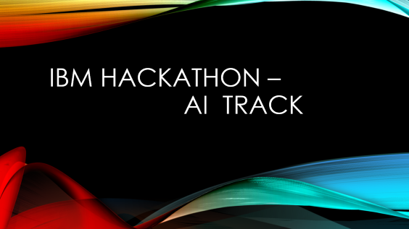
IBM Hackathon - Tracks

Slide 3
IBM Hackathon – AI Track

Slide 4
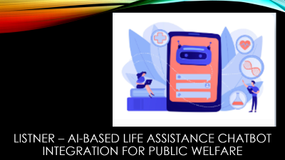
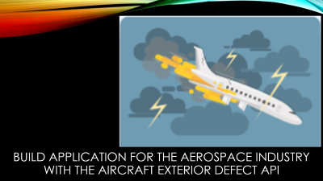
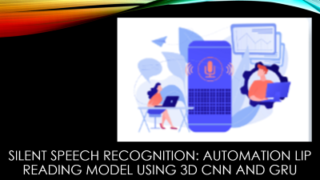

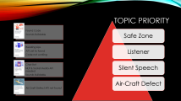
Topics given

Slide 5
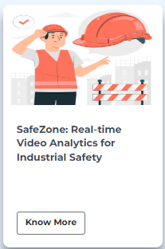
Safe Zone: real-time video Analytics for Industrial safety

Slide 6
Expected Solution
The objective is to leverage Deep Learning techniques to monitor live video feeds and provide real time hazard detection, prompt alerts, and interventions, enhancing industrial safety and preventing accidents in industrial environments.
Python
Artificial Intelligence
Deep Learning
Object Detection
Yolo
Flask

Slide 7
Expected Solution
Python
Artificial Intelligence
Deep Learning
Object Detection
Yolo
Flask
Monitor Live Video Feeds
Real Time Hazard Detection
Prompt alerts and Interventions
Enhancing Industrial Safety
Website to input these live video feeds
And generate output as below

Slide 8
Required Skills
1
2
3
4
Safe Zone
Silent Speech
Listner
AirCraftDefect
Python
Artificial Intelligence
Deep Learning
Object Detection
Yolo
Flask
Artificial Intelligence
Deep Learning
Machine Learning
Python
Flask
Web Development
Advance AI Models
IBM Watson Studio
NLP
NLTK
Python
IBM Watson Assistance
Flask
Artificial Intelligence
Python
Object Detection
Artificial Intelligence
Computer Vision
Advance AI Models
IBM Watson Studio

Slide 9
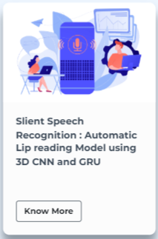
Silent speech recognition: automation lip reading model using 3d cnn and gru

Slide 10
Expected Solution
The objective is to create a data-driven solution using a combination of:
Convolution Neural Network (CNN)
Gated Recurrent Units
To accurately the speech form visual cues of lip movements captured in video data. The successful solution will provide an accurate and efficient silent speech recognition system that can interpret speech from visual cues of lip movement. It has the potential to revolutionize the communication, accessibility, and human-machine interaction in various domains, making it a versatile technology with wide ranging applications.
Artificial Intelligence
Deep Learning
Machine Learning
Python
Flask
Web Development
Advance AI Models
IBM Watson Studio

Slide 11
Expected Solution
Input Video/Live Video
Analyse in Website
Output speech
Visual cues of lip movements captured in video data.
These visuals can be Live or pre-recorded.
Combination of 3D-CNN and GRU is advised.
After analysis, a text should be provided, which conveys the message after analysing lip movements.
Artificial Intelligence
Deep Learning
Machine Learning
Python
Flask
Web Development
Advance AI Models
IBM Watson Studio

Slide 12
Required Skills
1
2
3
4
Safe Zone
Silent Speech
Listner
AirCraftDefect
Python
Artificial Intelligence
Deep Learning
Object Detection
Yolo
Flask
Artificial Intelligence
Deep Learning
Machine Learning
Python
Flask
Web Development
Advance AI Models
IBM Watson Studio
NLP
NLTK
Python
IBM Watson Assistance
Flask
Artificial Intelligence
Python
Object Detection
Artificial Intelligence
Computer Vision
Advance AI Models
IBM Watson Studio

Slide 13
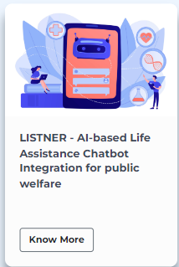
Listner – ai-based life assistance chatbot integration for public welfare

Slide 14
Expected Solution
The expected solution should have the following features:
Fully function AI-powered Chatbot capable of providing assistance and support in multiple areas.
Backend infrastructure developed using Flask, enabling seamless integration and communication with the chatbot.
Integration of either WhatsApp or Telegram API to facilitate user interactions through popular messaging platforms.
Integration of OpenAI GPT or similar NLP API for effective understanding and response generation based on user queries.
Implement of sentiment analysis API to extract emotional insights from conversations and deliver empathetic and personalized support.
Integration of the Twilio API or a similar solution for sending SMS or phone notification to support staff in critical situations.
Documentation providing guidelines for maintenance, deployment and further deployment of the chatbot.
NLP
NLTK
Python
IBM Watson Assistance
Flask
Artificial Intelligence

Slide 15
Expected Solution
NLP
NLTK
Python
IBM Watson Assistance
Flask
Artificial Intelligence
Fully function AI-powered Chatbot capable of providing assistance and support in multiple areas.
Backend infrastructure developed using Flask, enabling seamless integration and communication with the chatbot.
Integration of either WhatsApp or Telegram API to facilitate user interactions through popular messaging platforms.
Integration of OpenAI GPT or similar NLP API for effective understanding and response generation based on user queries.
Implement of sentiment analysis API to extract emotional insights from conversations and deliver empathetic and personalized support.
Integration of the Twilio API or a similar solution for sending SMS or phone notification to support staff in critical situations.
Documentation providing guidelines for maintenance, deployment and further deployment of the chatbot.

Slide 16
Required Skills
1
2
3
4
Safe Zone
Silent Speech
Listner
AirCraftDefect
Python
Artificial Intelligence
Deep Learning
Object Detection
Yolo
Flask
Artificial Intelligence
Deep Learning
Machine Learning
Python
Flask
Web Development
Advance AI Models
IBM Watson Studio
NLP
NLTK
Python
IBM Watson Assistance
Flask
Artificial Intelligence
Python
Object Detection
Artificial Intelligence
Computer Vision
Advance AI Models
IBM Watson Studio

Slide 17
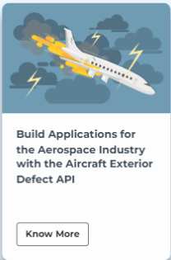
Build application for the aerospace industry with the aircraft exterior defect api

Slide 18
Expected Solution
The Expected Solution should have feature like:
Application framework integrating the Aircraft Exterior Defect API and supporting user interactions and data management.
User-friendly interface allowing users to upload aircraft exterior images and initiate defect analysis.
Integration of the defect detection algorithms from the API to automatically identify and highlight potential defects on uploaded images
Image analysis algorithm and techniques are implemented to provide detailed defect information, including size, severity location, and potential causes.
Generation of comprehensive defect reports, including annotated images and recommended actions for repair or further investigation.
Database or Storage system for storing and organizing inspection records for future reference and analysis.
Security measure are implemented to protect the confidentiality and integrity of uploaded images and inspection data.
Scalable and robust application architecture capable of handling concurrent image uploads and processing requests.
Python
Object Detection
Artificial Intelligence
Computer Vision
Advance AI Models
IBM Watson Studio

Slide 19
Expected Solution
Python
Object Detection
Artificial Intelligence
Computer Vision
Advance AI Models
IBM Watson Studio
Application framework integrating the Aircraft Exterior Defect API and supporting user interactions and data management.
User-friendly interface allowing users to upload aircraft exterior images and initiate defect analysis.
Integration of the defect detection algorithms from the API to automatically identify and highlight potential defects on uploaded images
Image analysis algorithm and techniques are implemented to provide detailed defect information, including size, severity location, and potential causes.
Generation of comprehensive defect reports, including annotated images and recommended actions for repair or further investigation.
Database or Storage system for storing and organizing inspection records for future reference and analysis.
Security measure are implemented to protect the confidentiality and integrity of uploaded images and inspection data.
Scalable and robust application architecture capable of handling concurrent image uploads and processing requests.

Slide 20
Required Skills
1
2
3
4
Found Code
Sounds Buildable
Reading Lips
API yet to found
Chat Bot
NLP & Social Media API needed
Sounds Buildable
Air-Craft Defect API not found
Safe Zone
Silent Speech
Listner
AirCraftDefect
Python
Artificial Intelligence
Deep Learning
Object Detection
Yolo
Flask
Artificial Intelligence
Deep Learning
Machine Learning
Python
Flask
Web Development
Advance AI Models
IBM Watson Studio
NLP
NLTK
Python
IBM Watson Assistance
Flask
Artificial Intelligence
Python
Object Detection
Artificial Intelligence
Computer Vision
Advance AI Models
IBM Watson Studio

Slide 21
Topic Priority
Found Code
Sounds Buildable
Reading Lips
API yet to found
Code not working
Chat Bot
NLP & Social Media API needed
Sounds Buildable
Air-Craft Defect API not found
Safe Zone
Listener
Silent Speech
Air-Craft Defect

Slide 22
Required Skills
1
2
3
4
Safe Zone
Silent Speech
Listner
AirCraftDefect
Python
Artificial Intelligence
Deep Learning
Object Detection
Yolo
Flask
Artificial Intelligence
Deep Learning
Machine Learning
Python
Flask
Web Development
Advance AI Models
IBM Watson Studio
NLP
NLTK
Python
IBM Watson Assistance
Flask
Artificial Intelligence
Python
Object Detection
Artificial Intelligence
Computer Vision
Advance AI Models
IBM Watson Studio

Slide 23
Datasets Links
Dataset 1
Gloves
Goggles
Helmet
Mask

Slide 24
Architecture
Architecture
Monolithic Architecture
Micro-Service Architecture
Serverless Architecture
Peer – to – Peer

Slide 25
Architecture
Architecture
1 Tier
2 Tier
3 Tier
In - Tier

Slide 26
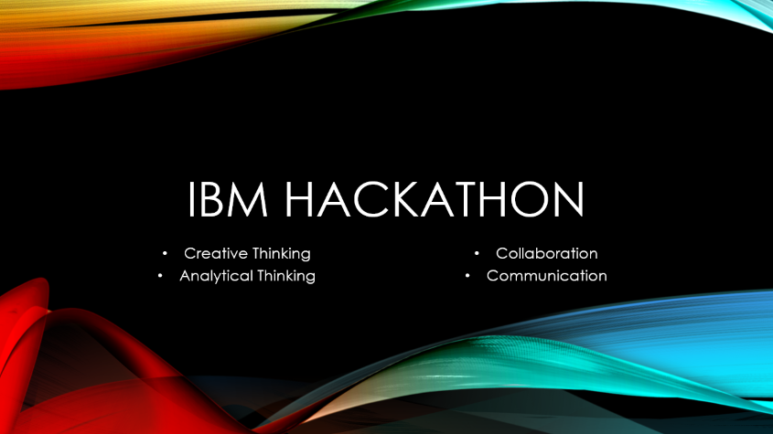
Summary

Slide 27
All the best guys
Regards
Trello Link
Git-Hub

